Slide 1
Uranium Working Group (UWG)
Public Meeting
Old Dominion Agricultural Complex
October 17, 2012
Maureen Dempsey, MD, FAAP
Chief Deputy Commissioner, Virginia Department of Health

Slide 2
Presentation Overview
UWG & VDH overview
Review of assigned tasks from the Governor’s Directive
VDH programs involved in UWG
Review of water meetings
Agreement State discussion
VDH resources needed in the event the moratorium is lifted
Update on Uranium Study status
Summary

Slide 3
Virginia Department of Health (VDH)
The Mission of the Virginia Department of Health is to promote and protect the health of all Virginians.
VDH’s Vision statement: "Healthy People in Healthy Communities”

Slide 4
VDH Scope of Authority
  Ensure clean, safe drinking water and protect the public from waterborne disease and water pollution.
  Prevent exposure to toxic substances and minimize exposure to radiation.
  Strengthen the culture of preparedness and respond in a timely manner to any emergency affecting public health.
  Promote systems, policies and practices that facilitate improved health for all Virginians.

Slide 5
Uranium Working Group (UWG)
On January 19, 2012 Governor McDonnell created the UWG consisting of staff from the Department of Mines, Minerals and Energy (DMME), Department of Environmental Quality (DEQ) and Department of Health (VDH).
The role of the UWG is fact finding and to support informed decision making, NOT to make a recommendation on the moratorium.
The Governor provided the UWG with 18 tasks to complete and present their findings to the Coal and Energy Commission by December 1, 2012.

Slide 6
UWG - VDH Deliverables
VDH is specifically tasked with the following:
  Assess whether the Virginia regulatory framework needs to be more stringent than existing federal regulations;
  Investigate the potential to become an agreement state under the U.S. Nuclear Regulatory Commission (NRC) for oversight of uranium milling;
  Establish the parameters of an active epidemiological surveillance program;

Slide 7
UWG - VDH Deliverables (cont’d)
  Determine the measures necessary to proactively protect the public and worker health;
  Plan for instituting a radon program;
  Determine what additional statutory/regulatory authority might be needed to ensure private well water quality;

Slide 8
UWG - VDH Deliverables (cont’d)
  Define parameters for a full environmental impact analysis;
  Establish a coordinated plan for conducting meaningful public outreach and input;
  Evaluate engineering designs and best management practices to prevent the release of radionuclides into ground and/or surface waters;

Slide 9
UWG - VDH Deliverables (cont’d)
  Develop a financial assurance program; and
  Extensively consider and seek public input.

Slide 10
VDH Programs Involved in UWG
Division of Radiological Health (DRH)
Office of Drinking Water (ODW)
Office of Epidemiology (EPI)
Office of Family Health Services (OFHS)
Office of Minority Health and Health Equity (OMHHE)
Office of Environmental Health Services (OEHS)
Local Health Departments
The following slides will provide an overview of these programs.

Slide 11
Division of Radiological Health (DRH)
  VDH’s Division of Radiological Health is the Commonwealth’s radiation control agency; that is, the lead coordinating agency for radioactive materials.
Virginia became an Agreement State for radioactive materials licensing and inspections in 2009.
  This agreement does not include uranium milling. This will be discussed in later slides.
DRH regulations reside in 12VAC5-481, “Virginia Radiation Protection Regulations.”

Slide 12
DRH (cont’d)
Radioactive Materials Program:
  6 FTEs and 2 wage employees
  419 specific licensees
  Perform licensing and inspecting
  Approximately 2,900 generally licensed entities
X-ray Program:
  7 FTEs and 1 wage employee
  Permit approximately 19,000 registrants
  Inspect approximately 1,500 x-ray machines annually

Slide 13
DRH (cont’d)
Environmental Monitoring and Emergency Preparedness:
  3 FTE’s and 3 wage employees
  Environmental sampling and analyses
  Emergency response training, proficiency
  Quarterly and annual reports

Slide 14
Background Radiation Levels
Average individual radiation dose in the United States is approximately 620 mrem per year. Of this, 310 is from naturally occurring sources (solar, terrestrial and radon) and 310 is from man made sources (medical).
Varies depending on location (i.e. higher elevations – increased dose).

Slide 15
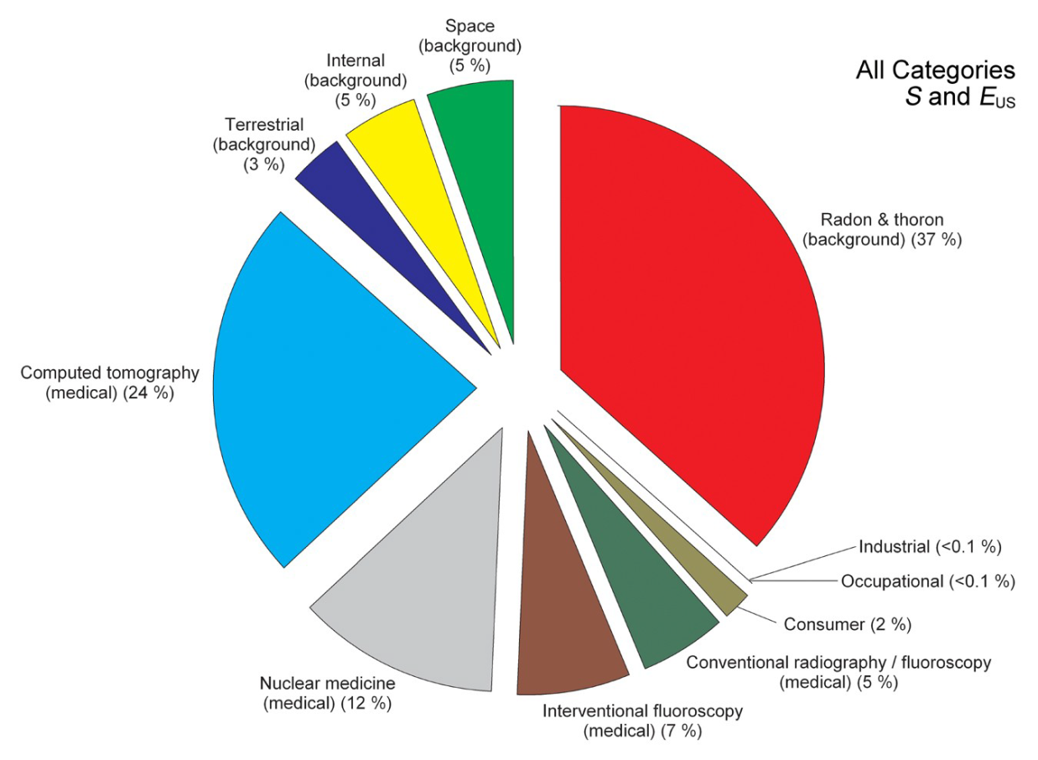
Radiation Dose
Percent of various sources of exposure to the total dose per individual in the U.S. population.
Total Avg.
Dose:
620 mrem/yr

Slide 16
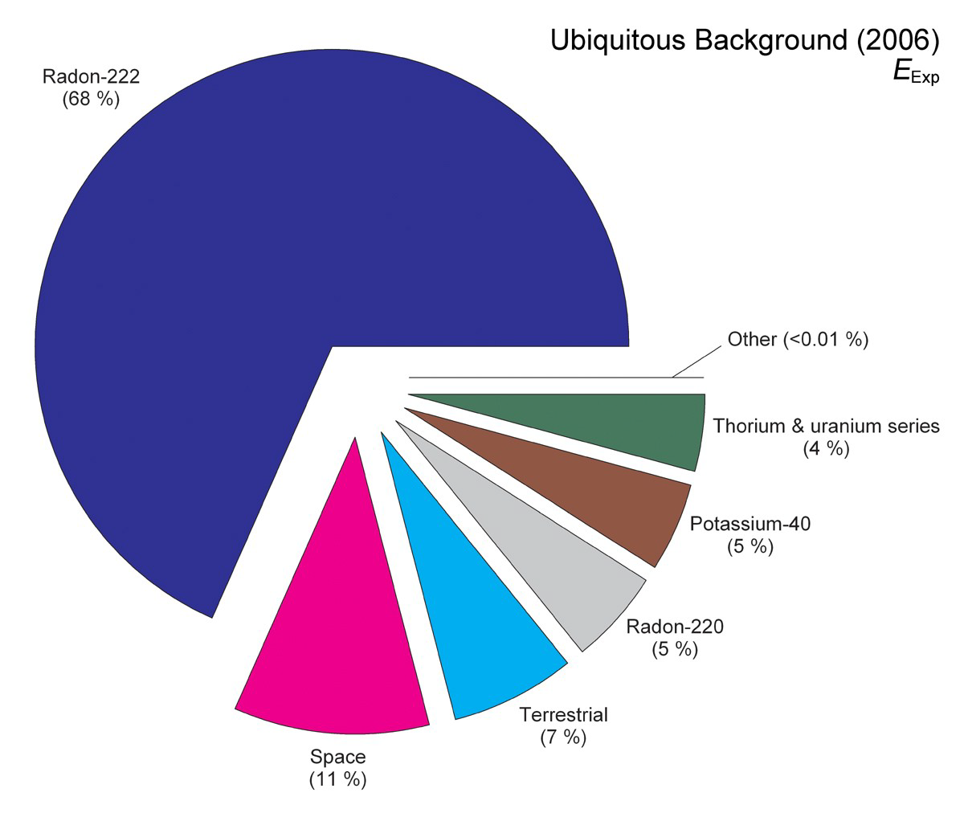
Radiation Dose (cont’d)
Background Dose:
Estimated population dose among the various sources of background radiation – does NOT include medical exposure.
Total Background Dose:
310 mrem/yr

Slide 17
Radon
Radon is a naturally occurring radioactive gas.
  Decay of uranium in soil, rock and water.
Average indoor radon level is about 1.3 picocuries per liter (pCi/L) in air in the United States (1991 national residential radon survey by the EPA).
  The average outdoor level is about 0.4 pCi/L.
The EPA recommends that indoor radon levels above 4 pCi/L be mitigated.

Slide 18
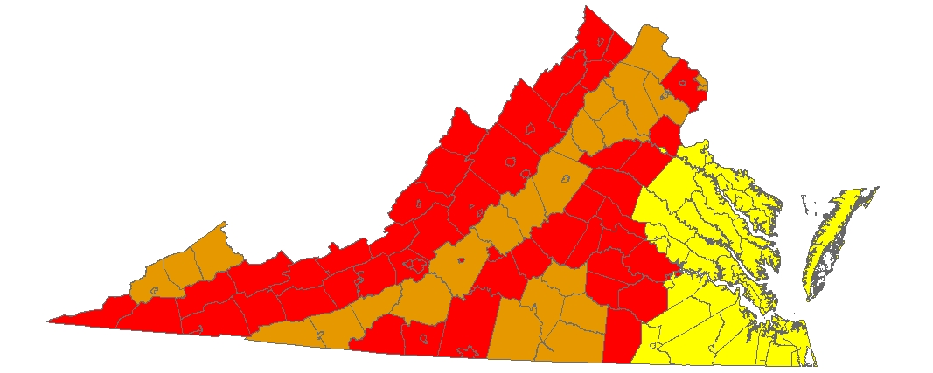
Radon (cont’d)
 | Zone 1 counties have a predicted average indoor radon screening level greater than 4 pCi/L (picocuries per liter) (red zones) | Highest Potential
 | Zone 2 counties have a predicted average indoor radon screening level between 2 and 4 pCi/L (orange zones) | Moderate Potential
 | Zone 3 counties have a predicted average indoor radon screening level less than 2 pCi/L (yellow zones) | Low Potential

Slide 19
Radon (cont’d)
DRH would need to institute an indoor radon monitoring program to assess baseline public exposures if the moratorium were to be lifted and a mine/mill permit granted.
Radon released from the mine and mill will be monitored to ensure compliance with regulatory standards.

Slide 20
Office of Drinking Water (ODW)
Public Water System Supervision (PWSS) Program
Public Waterworks are defined as an entity which: “Serves piped water for drinking or domestic use to (i) the public, (ii) at least 15 connections, or (iii) an average of 25 individuals for at least 60 days out of the year.”
PWSS Program: Ensures compliance with the Safe Drinking Water Act and the Virginia Waterworks Regulations.
  Sampling / Monitoring / Reporting
  Operations / Staffing
  Design / Construction

Slide 21
ODW PWSS Requirements
Adopt & Implement New Regulations
Compliance and Enforcement:
  Review Water Sample Results;
  Review Operation Reports;
  Determine Compliance;
  Issue Notices of Violation (NOVs);
  Issue Consent Orders;
  Issue Operation Permits; and
  Review Plans & Issue Construction Permits.

Slide 22
ODW Safe Drinking Water Act Monitoring
Initial radionuclide sampling for four (4) quarters.
Subsequent sampling frequency reduced if results are below maximum allowable contaminant levels.
Parameter | Public Water Supply Designated Rivers
Gross Alpha Particle Activity | 15 pCi/l
Beta Particle & Photon Activity | 4 mrem/yr
Combined Radium 226 & 228 | 5 pCi/l
Uranium | 30 ug/l
Zinc | 7,400 ug/l

Slide 23
Office of Epidemiology (OEpi)
Division of Surveillance & Investigation:
  Monitors the occurrence of reportable and emerging diseases and suspected outbreaks of illness (natural or otherwise).
  Provides recommendations and guidance to prevent the spread of communicable diseases.
  Investigates outbreaks of disease and other public health emergencies.
  Beach Recreational Waters Monitoring.

Slide 24
OEpi (cont’d)
Division of Environmental Epidemiology:
  Prevents and controls human diseases and conditions due to exposure to chemical and biological agents in the environment and transmission from animals to humans.
  Develops and maintains surveillance and outbreak investigations for:
    Environmental factors that may indicate a potential human health hazard;
    Diseases and conditions that may be due to exposure to certain environmental factors; and
    Diseases that are transmitted from animals to humans.

Slide 25
Office of Family Health Services (OFHS)
Focus on improving health of Virginians through prevention, health promotion, nutrition, child & family health, and surveillance of health risk factors.
Programs include:
  Newborn Screening;
  Chronic Disease Management and Prevention,
  Virginia Cancer Registry;
  Supplemental Nutrition for Women, Infants, & Children; and
  Surveillance – Cancer, Congenital Anomalies, Behavioral Risks.

Slide 26
Office of Minority Health and Health Equity (OMHHE)
Advances health equity by identifying health inequities and their root causes and promoting equitable opportunities to be healthy
Data analysis to identify health inequities and the distribution of health risks among demographic populations
Provision of resources and technical assistance to promote culturally and linguistically appropriate services
Community engagement with low income and racial/ethnic minority populations to address neighborhood and environmental risks
Identification of policy and organizational strategies to promote opportunities for all communities to be healthy

Slide 27
Office of Environmental Health Services (OEHS)
Protect public health by preventing the transmission of disease through food, milk, shellfish, water and sewage and to work in partnership with other agencies to protect the environment.
Programs include:
  Food and milk safety including restaurant inspection;
  Summer camps, campgrounds and marinas; and
  Private wells and onsite sewage systems.

Slide 28
Private Well Regulations
12VAC5-630-10 et seq.
Construction standards
Horizontal setbacks
Bacteriological water quality testing at initial well construction
No ongoing monitoring
Incomplete inventory
Multiple users

Slide 29
Private Wells: Concerns
No baseline data (quality or quantity)
No ongoing quantity standards
Financial impacts associated with any regulatory scheme
Non-drinking water/agricultural wells
Stakeholder concerns rated high in several studies
Therefore, VDH held Public Meetings on Private Well Regulation

Slide 30
VDH Public Meetings
VDH was tasked by the Governor with determining what additional statutory/regulatory authority might be needed to ensure private well water quality:
  Seven Meetings
    Four public comment sessions
    Three small group discussions
    Chatham, Warrenton, Virginia Beach
  Total number of attendees
    Public comment sessions
      177 attendees, 52 speakers
    Small group discussions
      47 participants, 20 public observers

Slide 31
Purpose of Public Meetings
VDH presented the public with four questions:
  What are the public’s concerns related to the impact of uranium mining and milling on water quality and quantity of private wells?
  What are the public’s concerns related to the impact of uranium mining and milling on recreational use of surface water?

Slide 32
Purpose of Public Meetings (cont’d)
  What role should VDH play in assuring that public health is protected in regard to private wells and recreational water use in regard to uranium mining and milling?
  What safeguards should be in place to protect private wells and recreational water?

Slide 33
Overarching Themes
Impacts to agriculture (economic and health);
Impacts to groundwater and surface water supplies (quality and quantity; private and public);
Baseline testing and monitoring (pre-mining, during operations, and long term);
Catastrophic events (weather related and operational failures);
Current regulatory structure and necessary changes (authority, expertise and resources, public input); and
Overall economic impacts.

Slide 34
Agreement State Discussion
If the moratorium on uranium mining were lifted:
  The NRC will regulate uranium milling; or
  Virginia may amend the existing agreement with the NRC to regulate uranium milling.
The following slides will discuss:
  Current NRC regulations;
  The Agreement State process; and
  Factors Virginia will consider in the decision to amend the agreement with the NRC.

Slide 35
Current NRC Mill Regulations
The NRC is the lead regulatory authority for uranium milling.
Current Milling regulations:
  Requirements for an Environmental Impact Statement and Report (10 CFR Part 51);
  Mill and tailings licensing specifications (10 CFR Part 40);
  Environmental monitoring (10 CFR Part 20 and 40);
  Public and worker radiation exposure limits (10 CFR Part 20); and
  Radiation survey requirements (10 CFR Part 20).

Slide 36
Mill Waste
Monitoring, Storage and Disposal
Milling results in tailings that are stored in lined impoundments.
Tailings Impoundments are:
  Double-lined with a clay under-liner (foundation);
  Designed for strength and low-permeability; and
  Monitored using a leak detection system under the liners and by sampling onsite test wells.
Wind-blown transport of particulates from mill tailings poses the greatest potential for offsite exposure.

Slide 37
Mill Waste Monitoring, Storage and Disposal (cont’d)
Wind-blown transport of particulates is controlled using best management practices including:
  Moisture controls such as sprayers;
  Interim covers; and
  Pool or pond saturation (i.e., water cover).
Effluents must be controlled and monitored to ensure air, surface water and groundwater are protected.
Processed water used in the mill is highly regulated.

Slide 38
Mill Closure and Decommissioning
Regulations require that a Reclamation Plan be submitted as part of a mill application.
Closure of the tailings impoundment involves dewatering and installing a cover:
  Earthen or approved alternative that meets the NRC seismic standards;
  Radon barrier located below frost depth;
  Self-sustaining vegetative cover and/or rock to control erosion and burrowing animals; and
  Designed for zero infiltration but includes sufficient area to accommodate conservative amount of in-leakage.

Slide 39
Mill Closure and Decommissioning (cont’d)
Long-term site maintenance and care is turned over to a custodian, usually the Department of Energy (DOE).
Custodial responsibilities include:
  Annual site monitoring and inspections to confirm the integrity of tailings retention systems and identify maintenance needs, if any.
  Inspection frequency based on site-specific information.
  Reporting results to the NRC.

Slide 40
Cost of Sustained Care
Operator-based funding to pay for state services is a policy decision that must be considered to avoid taxpayer burden.
There are no incremental costs for mine and mill site reclamation since assurance funds are required to be posted by the applicant/operator for this purpose.
Perpetual liability is assumed by the property owner.
The NRC requires financial arrangements for decommissioning, reclamation and long-term surveillance (10CFR40, Appendix A).

Slide 41
NRC Agreement State Decision
Factors to consider on whether or not to amend the agreement:
  State control vs. federal control;
  Institution of additional or more restrictive regulations beyond the NRC;
  Start-up costs;
  Staffing;
  Training requirements;
  Equipment; and
  Timeframe for amending the agreement (minimum of about three years).

Slide 42
Factors to Consider
State regulations may be more stringent than NRC’s.
Some areas being reviewed to determine if more restrictive milling regulations would be appropriate:
  Environmental monitoring frequencies and distances;
  Environmental monitoring reporting;
  Water treatment;
  Laboratory analysis; and
  Emergency response actions.
Public participation will be an integral component.

Slide 43
Factors to Consider (cont’d)
Cost considerations include:
  Staffing;
    Expertise needed is unique - qualified, experienced staff, particularly individuals with uranium experience
  Training;
  Equipment;
  Radiological monitoring, sampling and analysis;
  Responsibility to review designs, operation plans and procedures for proposed facilities;
  Inspecting the operating facility; and
  Approving a facility closure plan & decommissioning.

Slide 44
VDH –Additional Resource Needs
PROGRAM | CURRENT STAFFING | IF MORATORIUM LIFTED (mining) | IF AGREEMENT AMENDED (milling)
DRH: Radon | 0 | 1.5 FTE and $100,000 per year | __
DRH: Environmental Monitoring | 1.5 FTE and 3 Wage | 1 Wage and $45,000 per year | __
DRH: Emergency Preparedness | 1.5 FTE | Additional $10,000 per year | __
DRH: Radioactive Materials Program | 6 FTEs and 2 Wage | 0 additional | About 8 FTEs and $1 million per year (licensee fee based)

Slide 45
VDH - Additional Resource Needs (cont’d)
PROGRAM | CURRENT STAFFING | IF MORATORIUM LIFTED | IF AGREEMENT AMENDED
Office of Epidemiology | No uranium specific staff. Several Epis and one FTE toxicologist on staff. | 2 FTE epidemiologists ($90K each, one local, one central) 1 FTE environmental health educator ($65K) 1 FTE Data manager ($75K) $10K per year each for computer, travel, supplies Lab analysis ($75K/year) | __
Office of Drinking Water | No uranium specific staff. | ½ FTE ($40K) | __
Office of Family Health Services | No uranium specific staff. Several Epis on staff. Virginia Cancer Registry staff. | $10K per year for Cancer Registry training Surveillance efforts coordinated with OEpi staff | __
Office of Environmental Health Services & Community Health Services | No uranium specific staff. | 6 FTEs plus sampling and analytical costs =$1,858K | __
Office of Minority Health and Health Equity | No uranium specific staff. | 0 FTE | __
Notes:
45

Slide 46
Update on Uranium Study
VDH awarded Wright Environmental Services (WES) a contract to provide consulting services.
VDH and WES have reviewed prior and current studies and reports.
WES is providing VDH with options to consider as the agency completes tasks directed in the Governor’s letter of January 19th 2012.

Slide 47
Summary
Role of VDH is to:
  Ensure that all risks have been identified and quantified to the extent possible;
  Evaluate the extent to which risks can be mitigated; and
  Propose a regulatory framework to mitigate risks.
The role of the UWG is fact finding and to support informed decision making, NOT to make a recommendation on the moratorium.
Future role of VDH will depend on status of the Moratorium and the Agreement with the NRC.

Slide 48
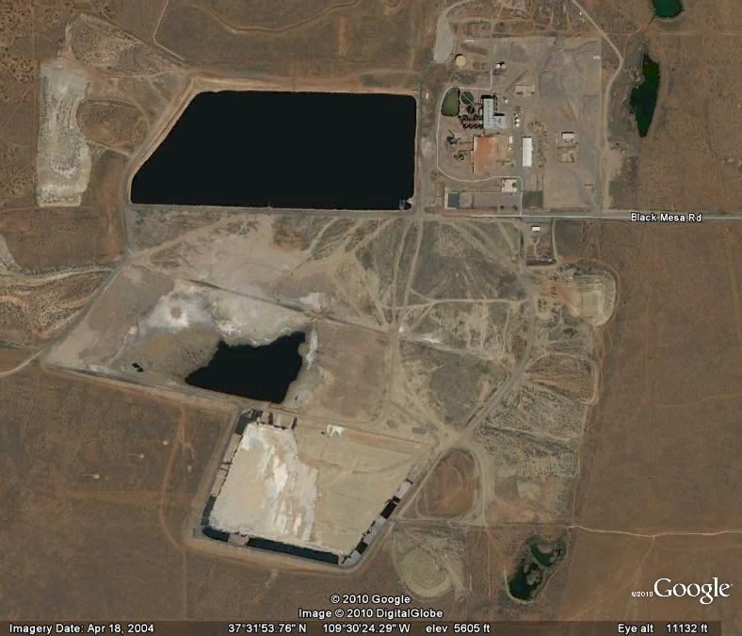
Mill and Tailings Site
White Mesa, Blanding, Utah

Slide 49
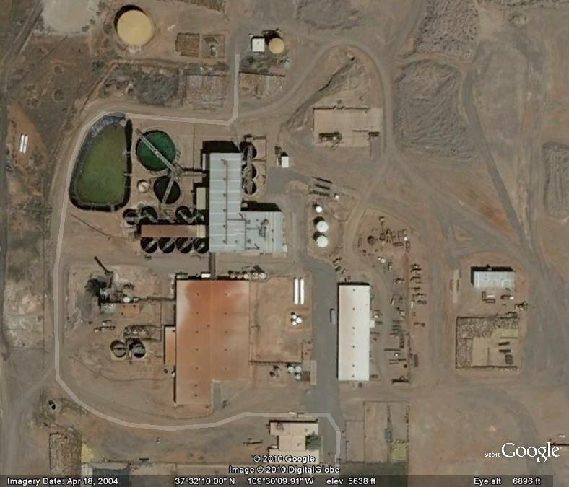
Mill Facility
White Mesa, Blanding, Utah

Slide 50
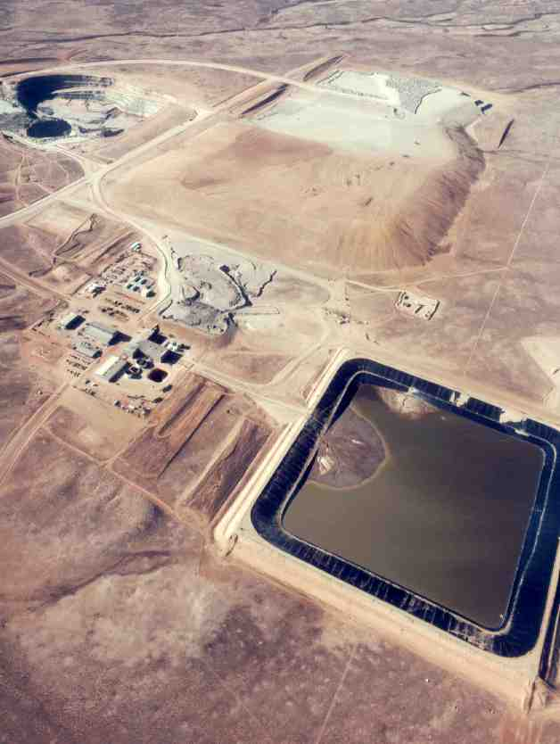
Tailings Disposal

Slide 51
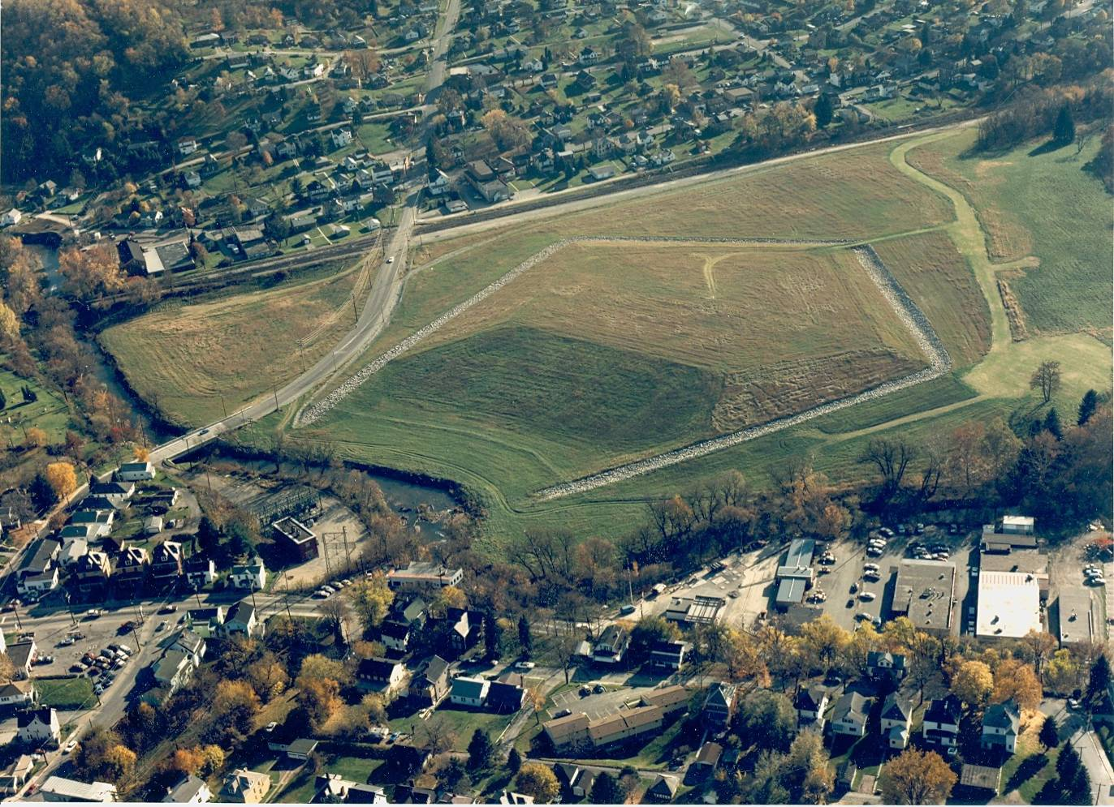
Canonsburg, PA

